Slide 1

Twitter Partnerships
@dwiadriansah

Slide 2
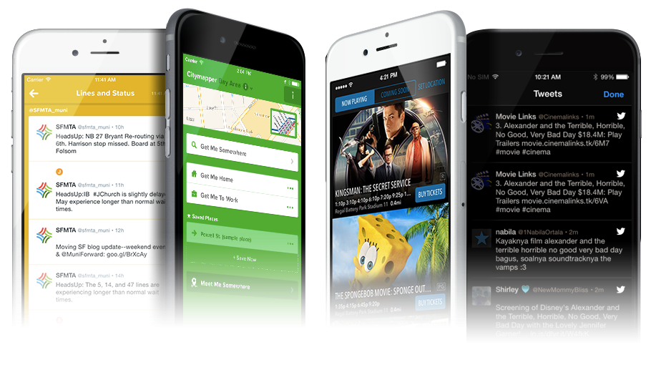

Fabric - mobile sdk
Easily display multiple Tweets from users on Twitter, or search terms related to your apps content to bring live conversations into your apps.
Get started: https://get.fabric.io/
Other Features: Crashlytics (Crash Analytics), Digits (Mobile Sign in), Log in With Twitter, Answers (Mobile Apps Analytics), MoPub (Ads)

Slide 3

INDOSAT #TWITBUY
#TwitBuy allows 68 Million Indosat mobile subscribers to purchase mobile products through DM.
This is another alternative of users to purchase SMS, Voice or Internet packages aside of USSD and SMS channels.

Slide 4

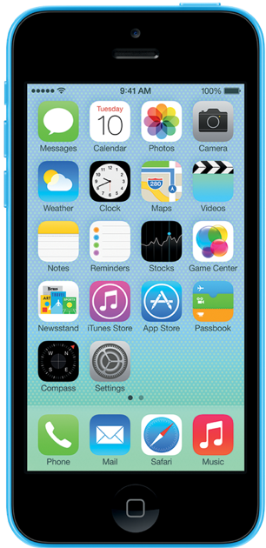
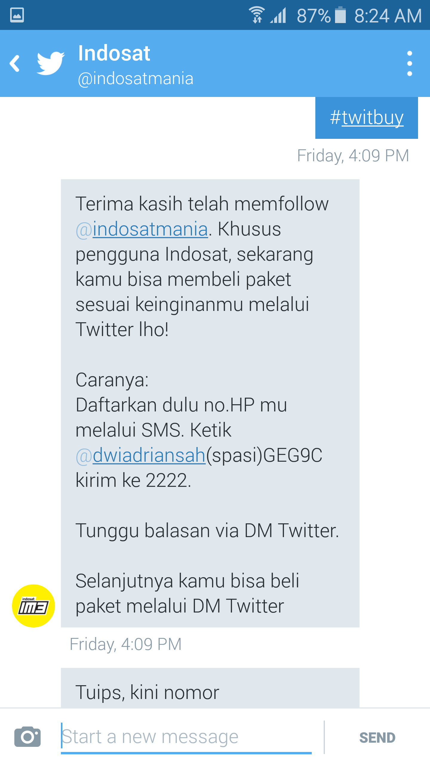
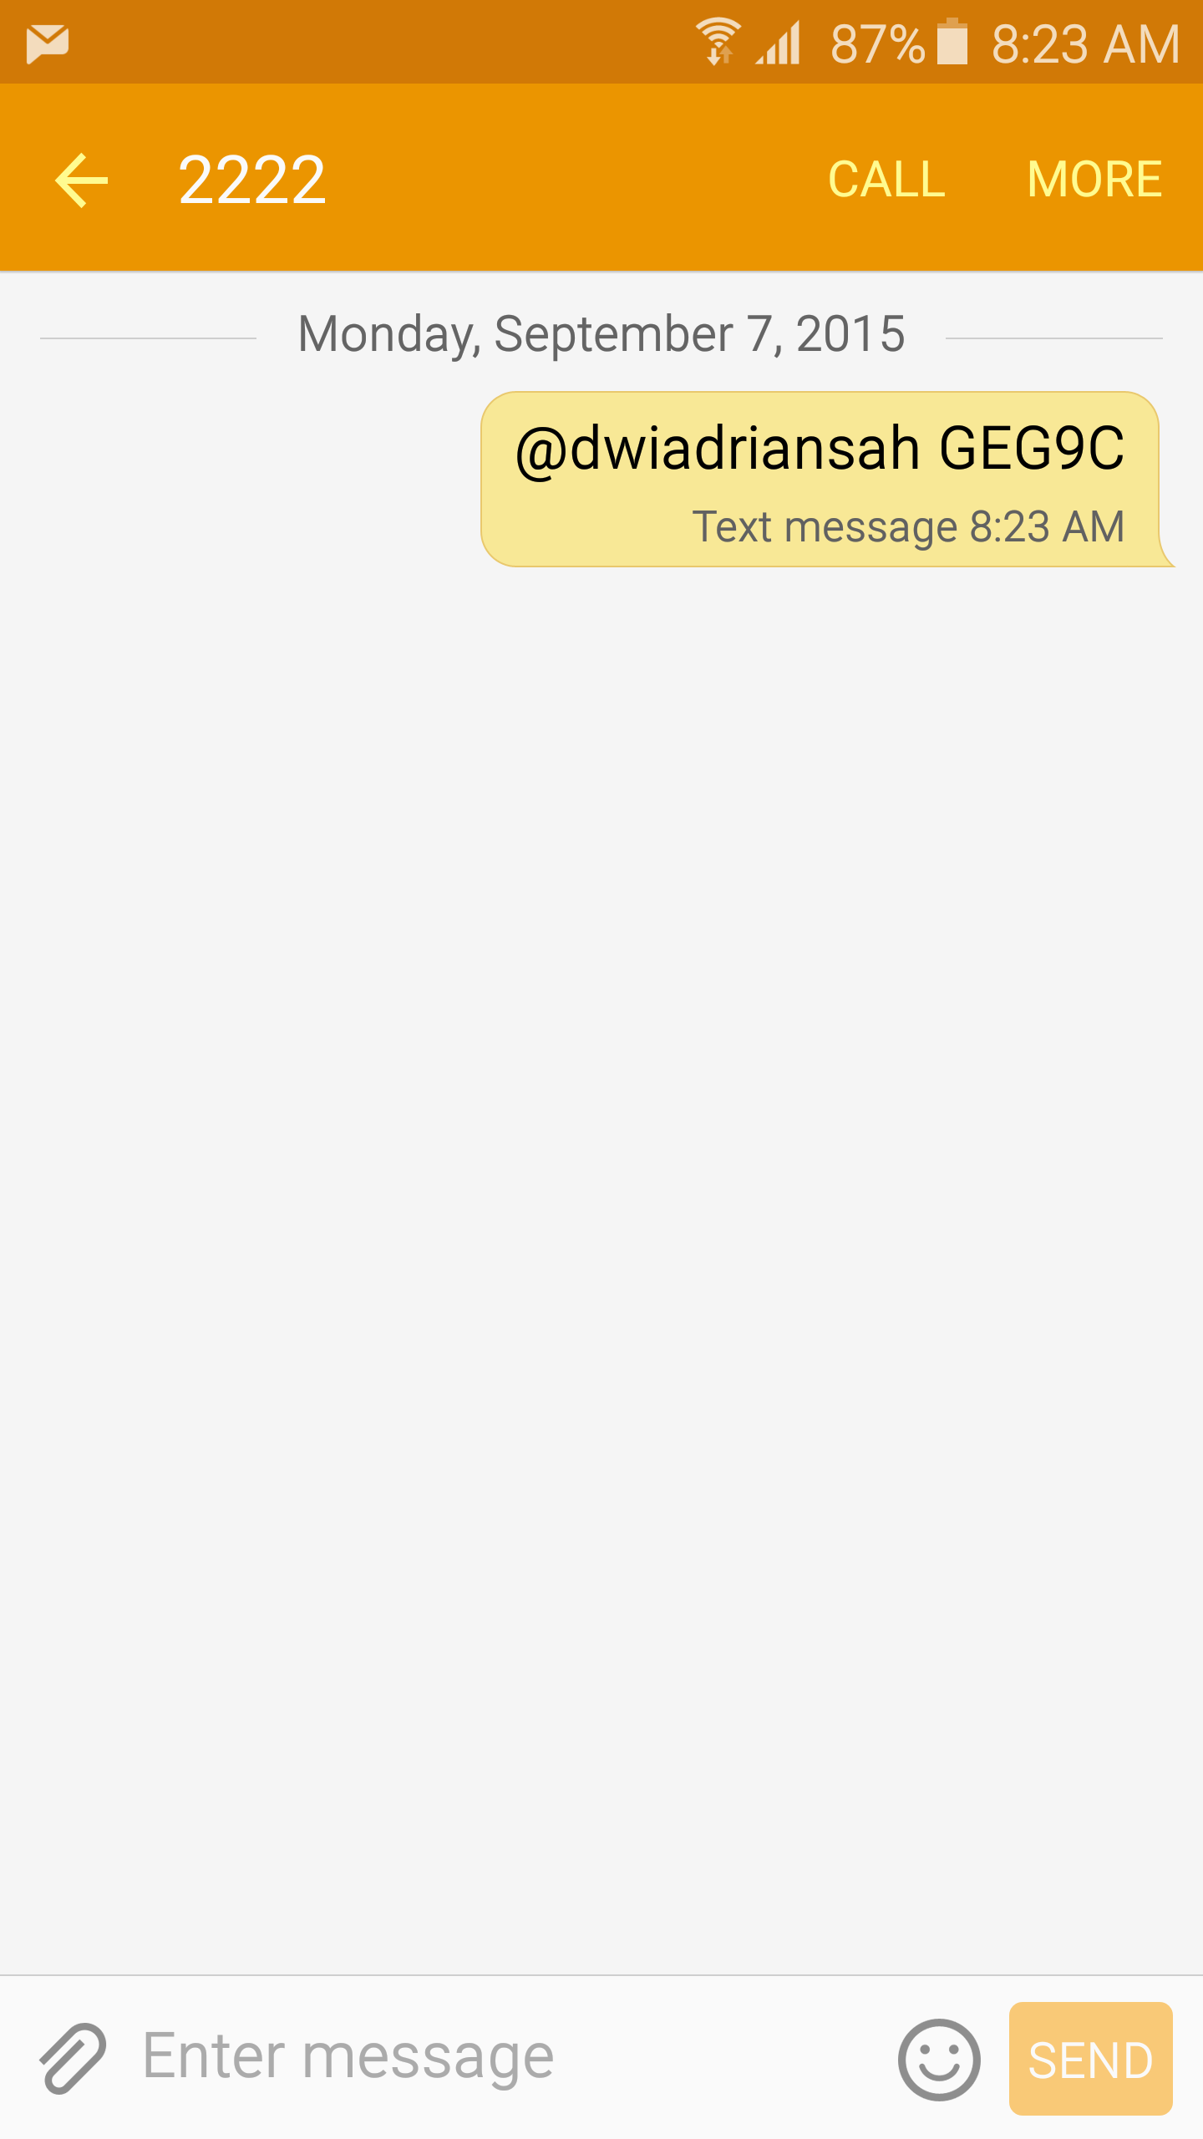
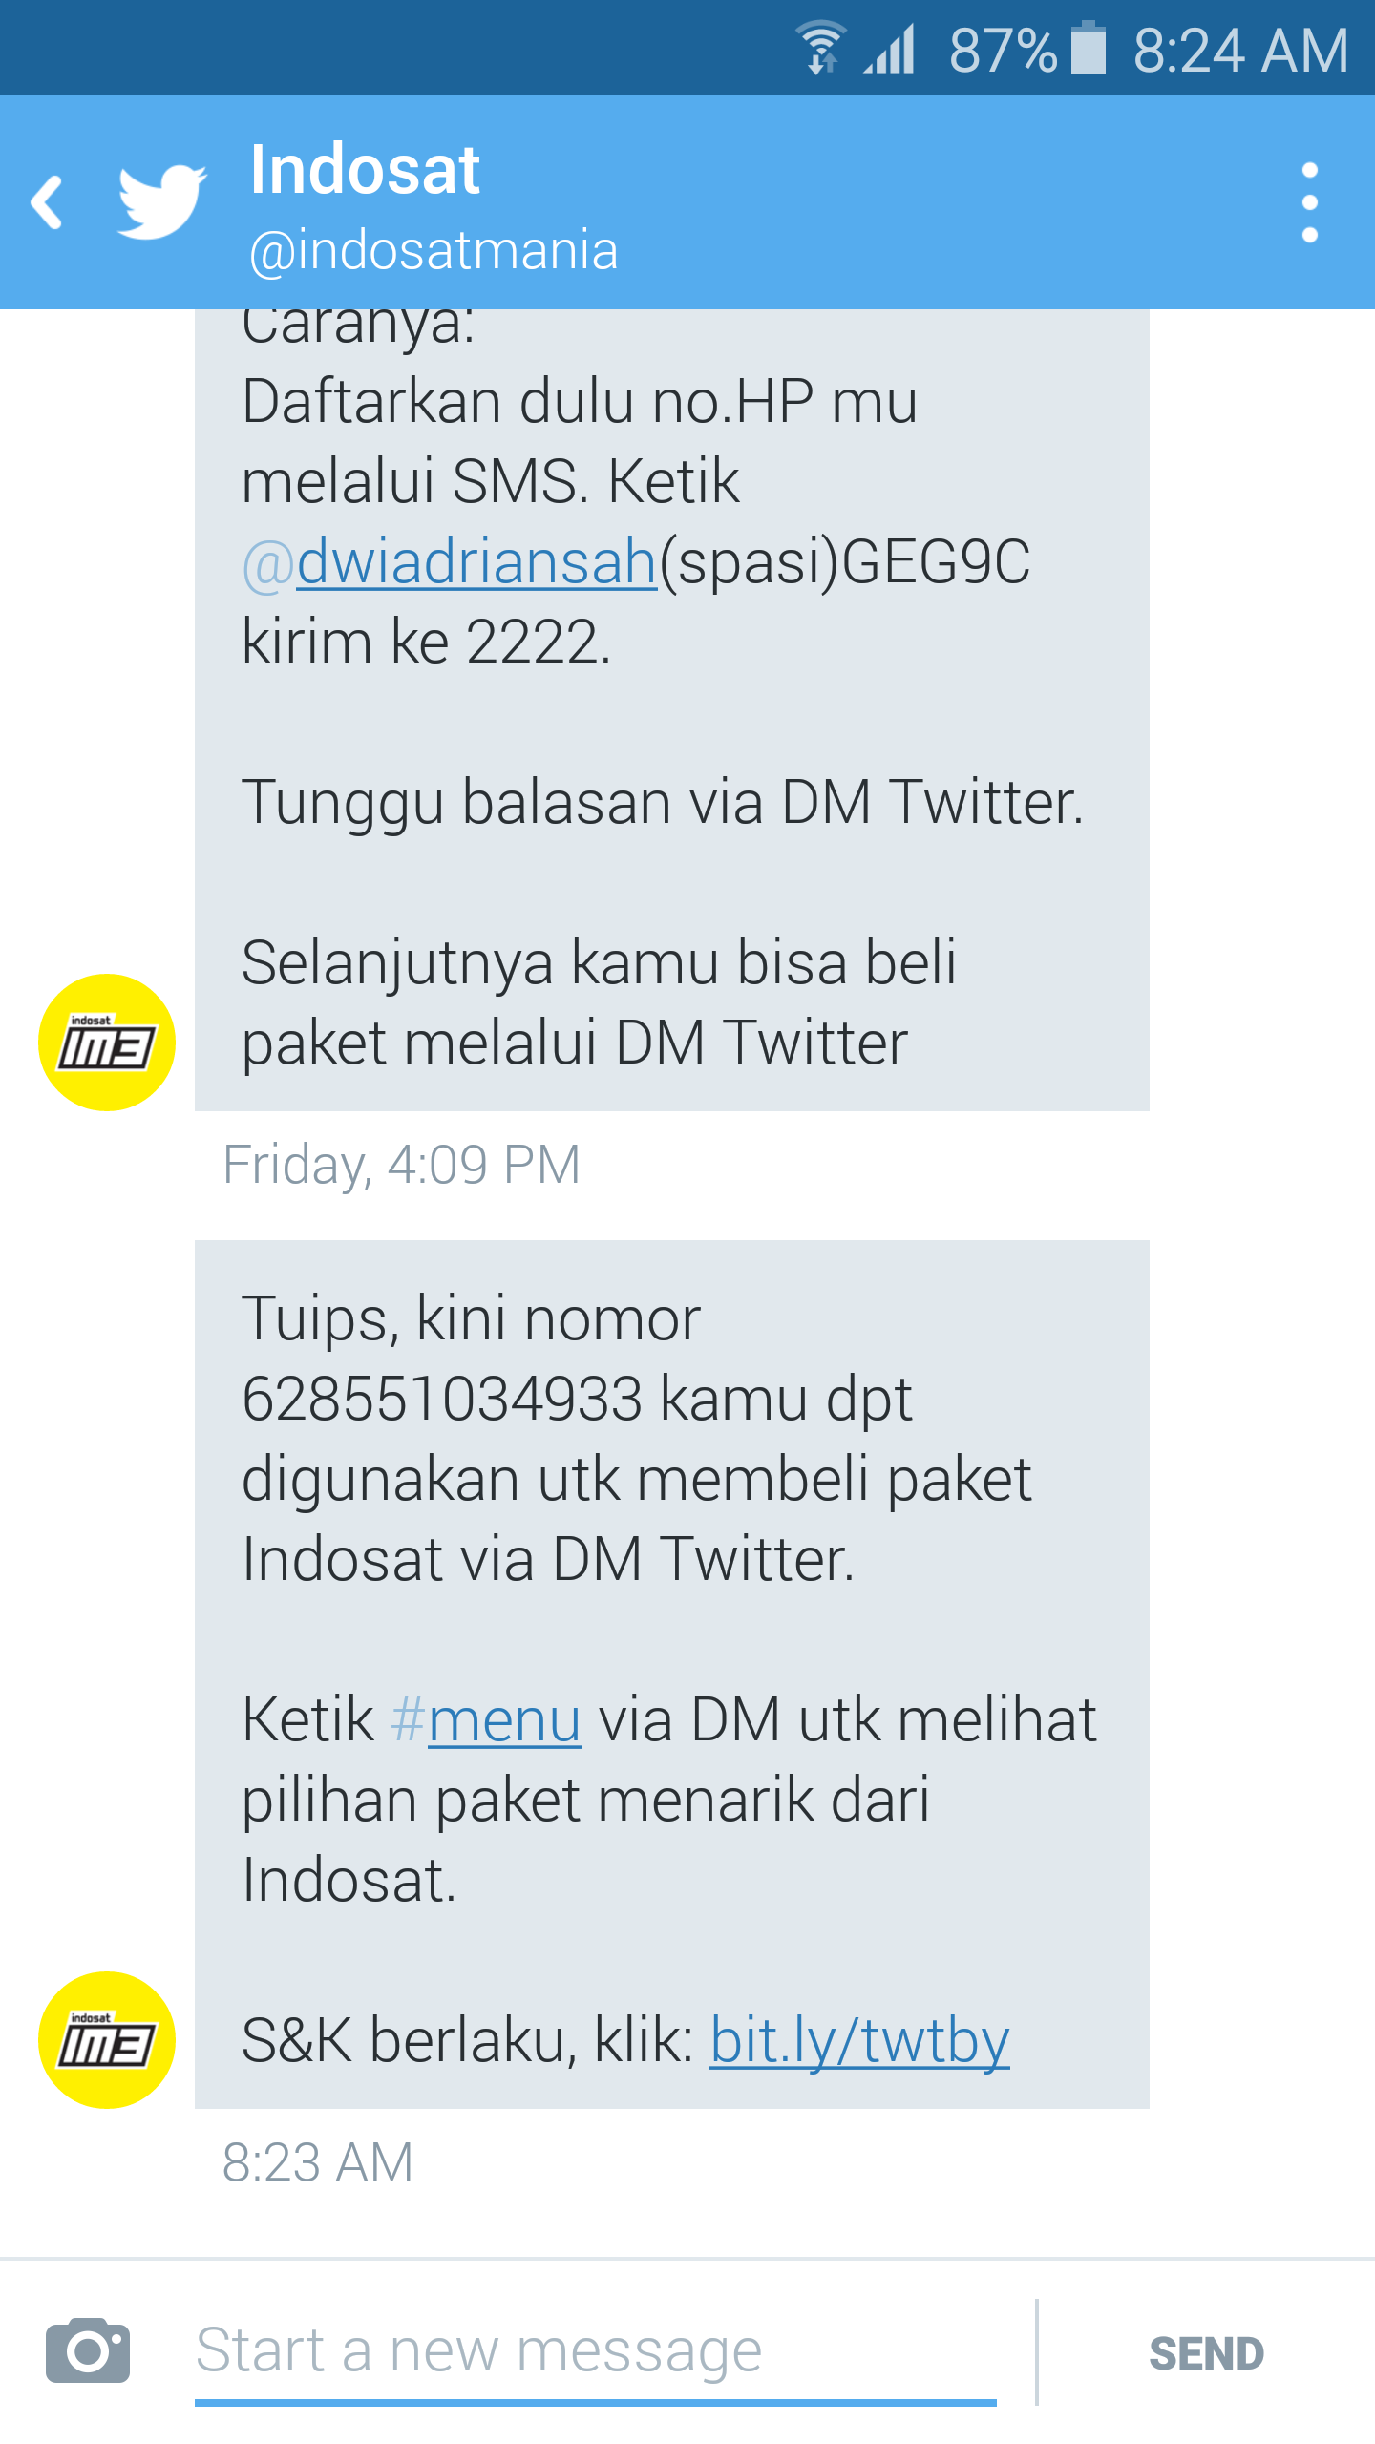

USER JOURNEY
1. Follow @Indosatmania and DM #TwitBuy to get started
2. Register Twitter handle via SMS
3. Receive SMS confirmation for successful registration
628551111111

Slide 5
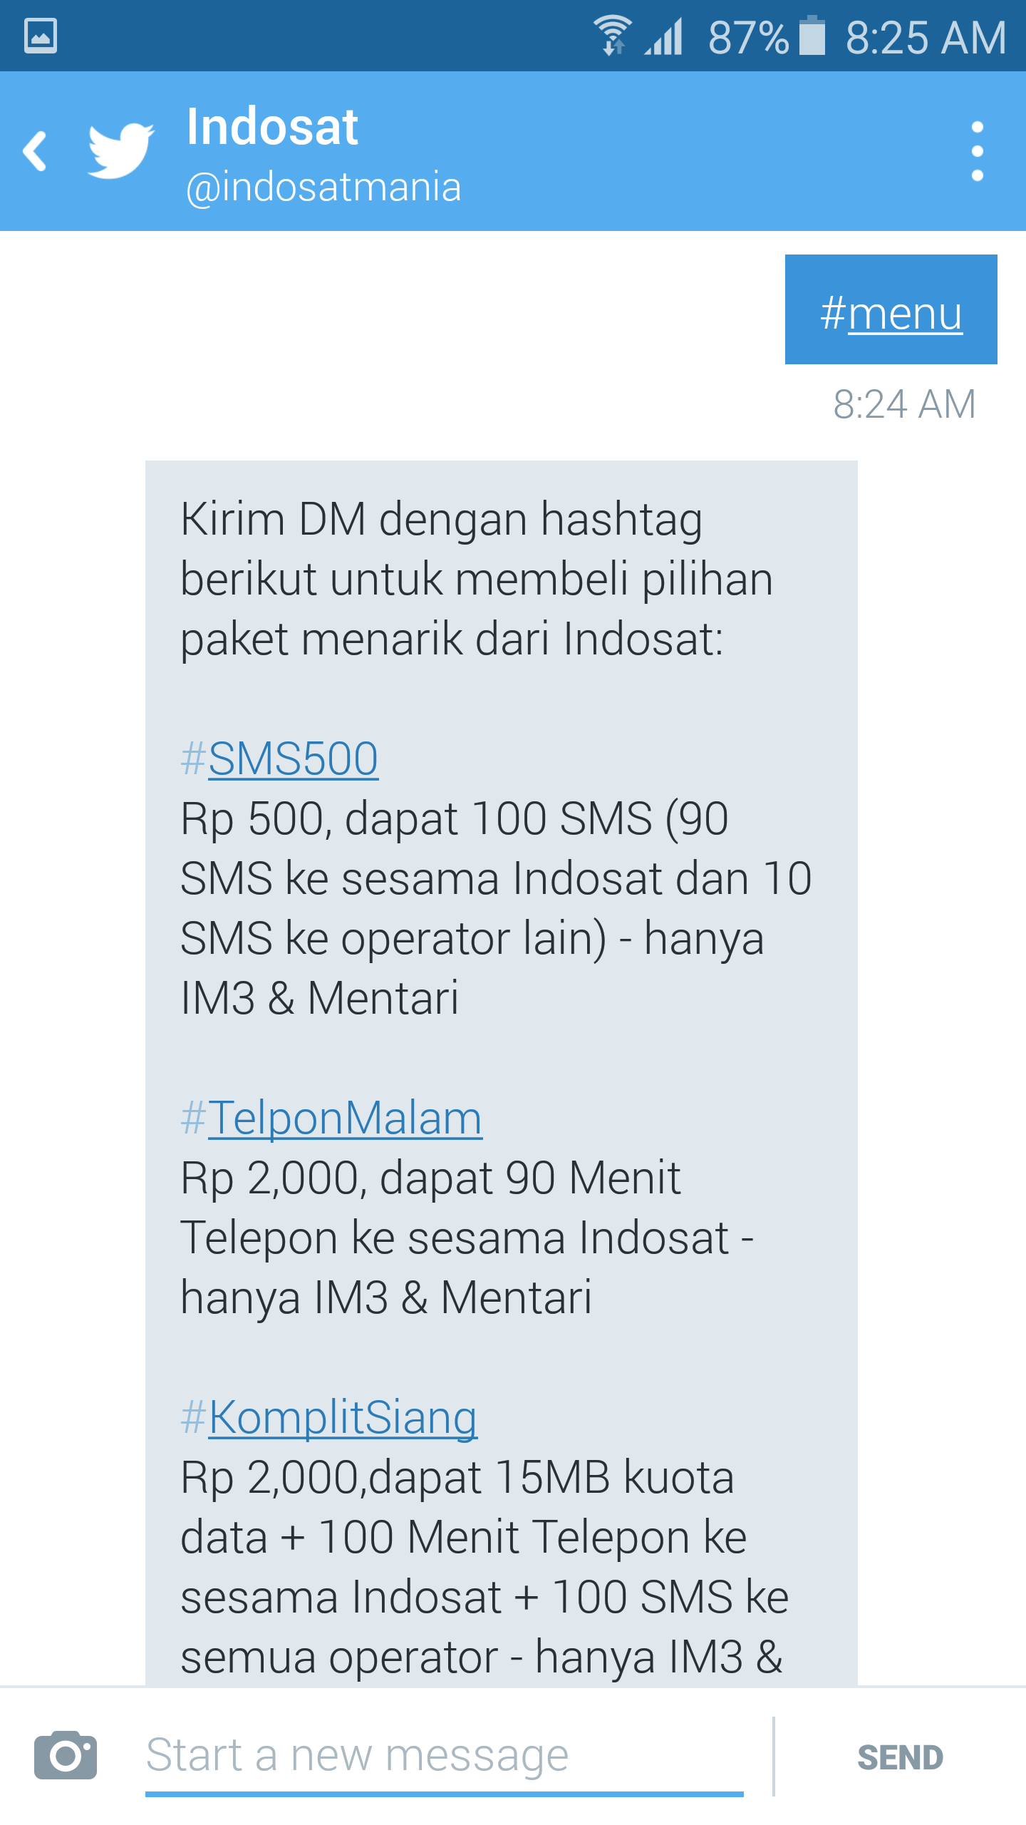
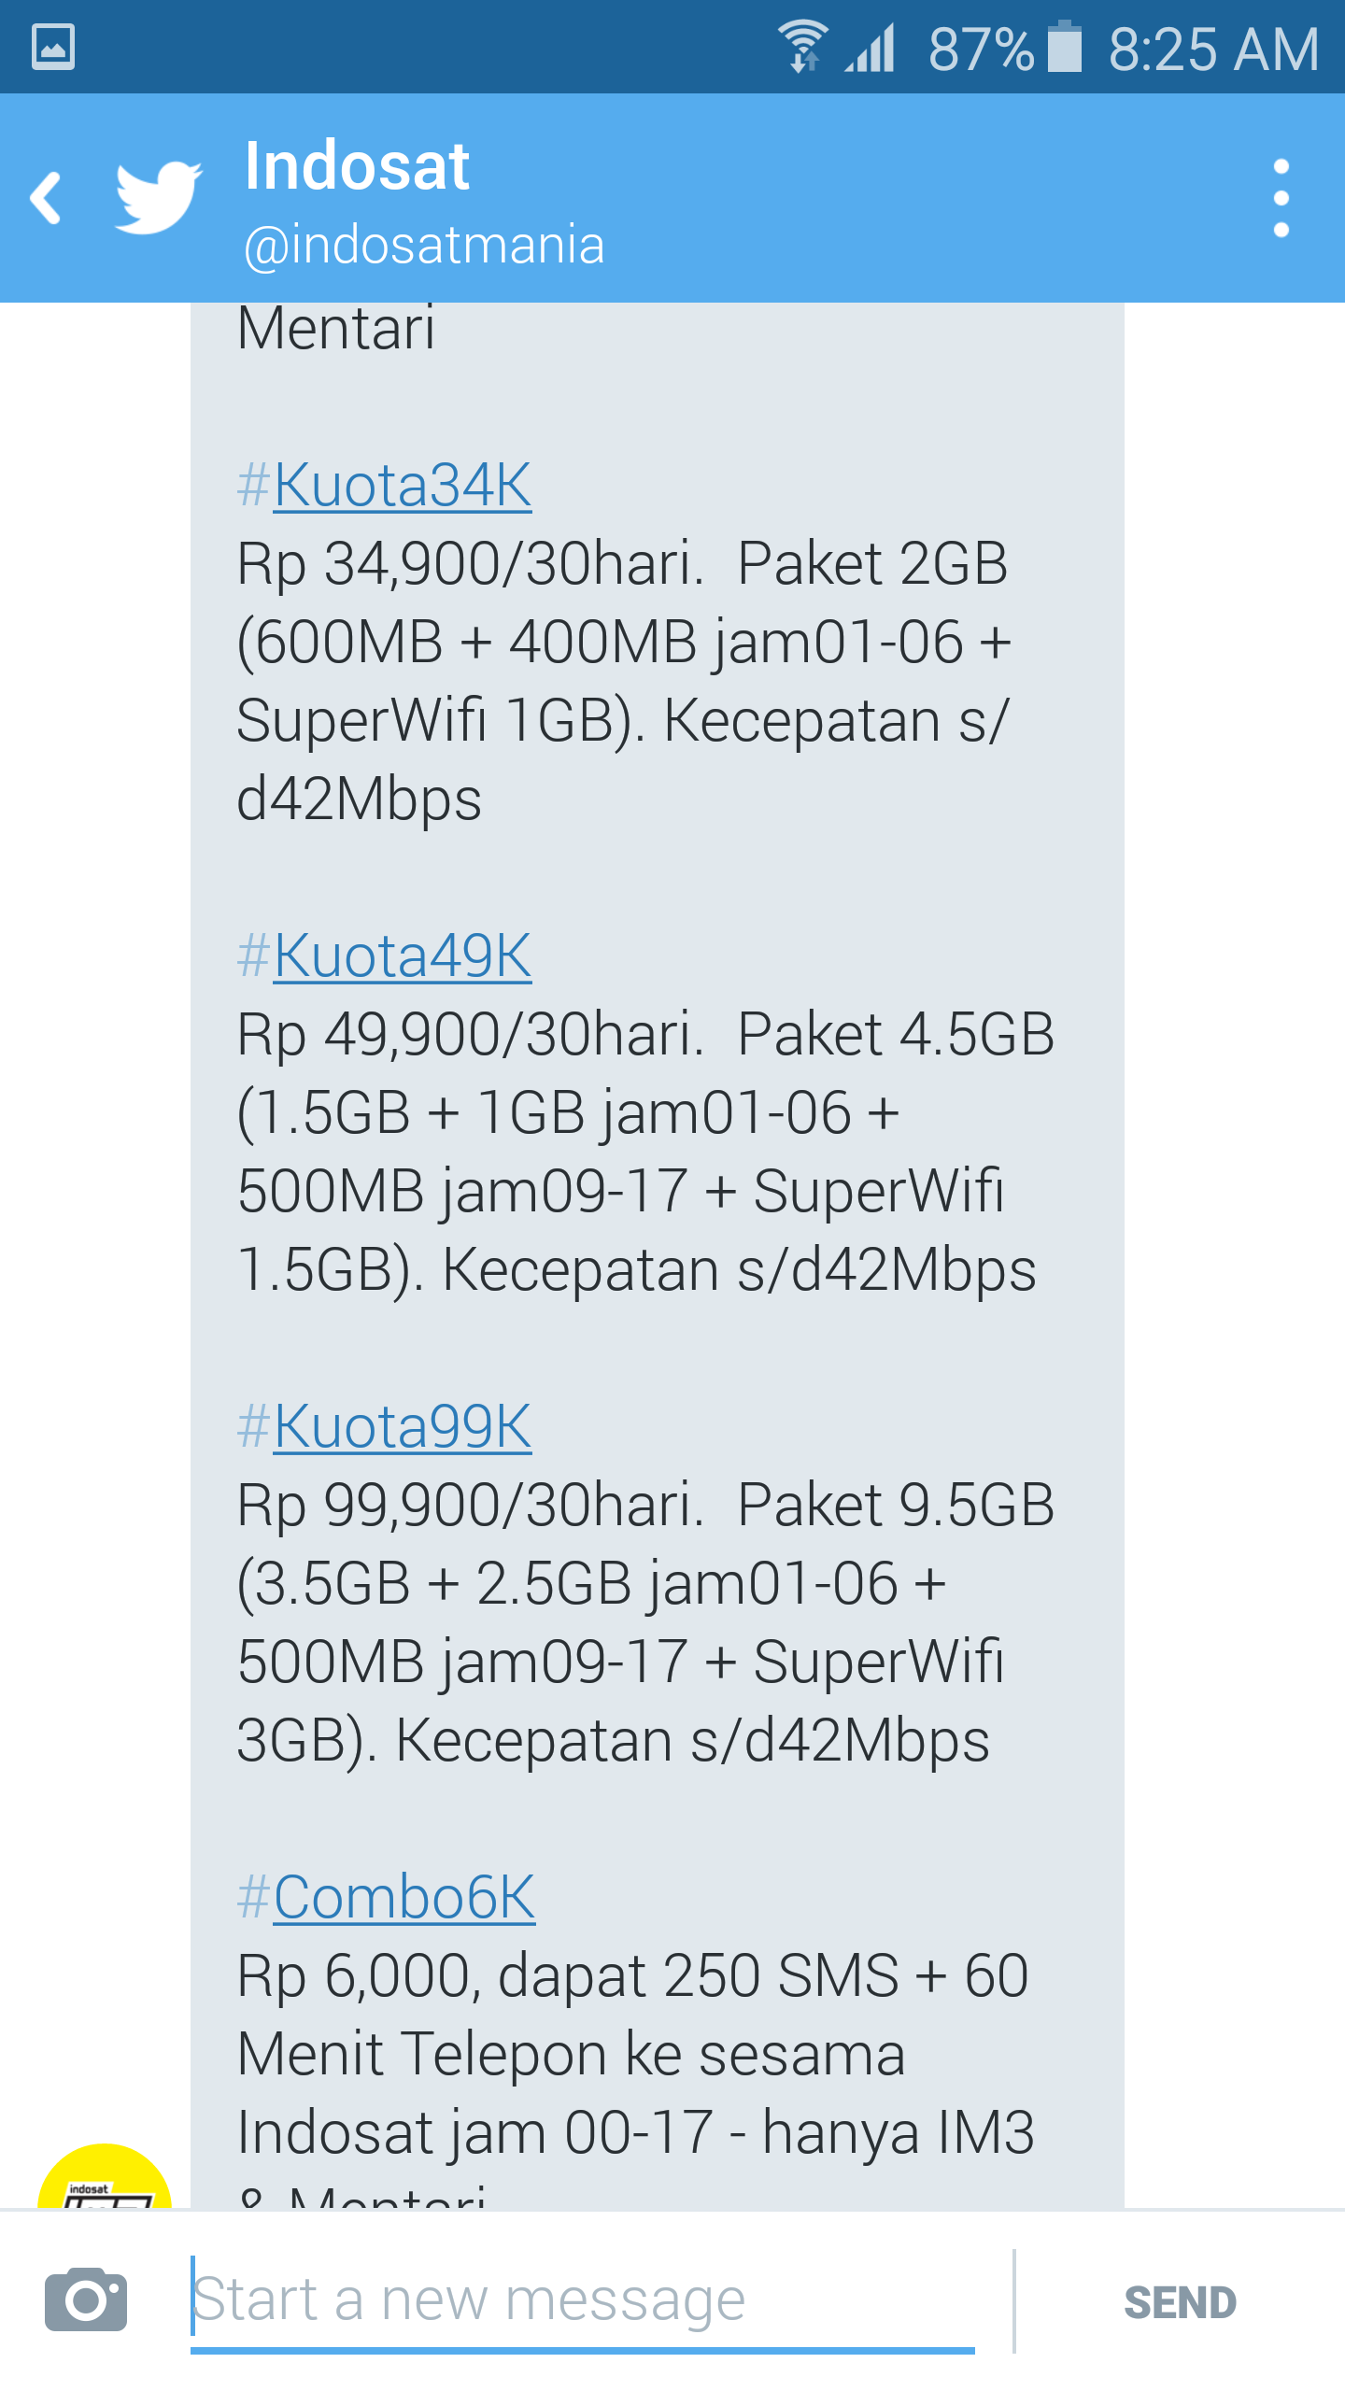
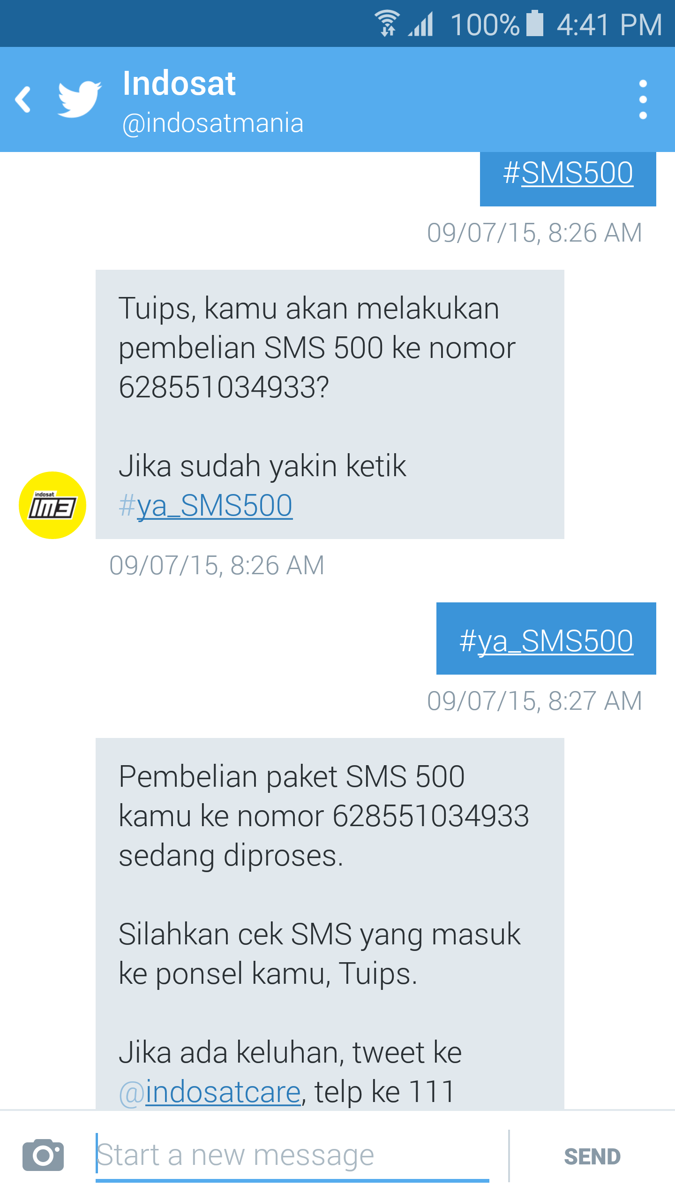
USER JOURNEY
4. DM #menu to get product info
4. DM #hashtag of product to purchase
5. Send confirmation to proceed
628551111111
628551111111

Slide 6


THE MOMENT IS NOW
@dwiadriansah

